Slide 1
IMDb Data Scraping and Visualization
By Arjun

Slide 2
Project Overview
This project focuses on extracting and analyzing movie data from IMDb for the year 2024. The task involves scraping data such as movie names, genres, ratings, voting counts, and durations from IMDb's 2024 movie list using Selenium. The data will then be organized genre-wise, saved as individual CSV files, and combined into a single dataset stored in an SQL database. Finally, the project will provide interactive visualizations and filtering functionality using Streamlit to answer key questions and allow users to customize their exploration of the dataset.

Slide 3
Technologies & Tools Used
Selenium: For dynamic web scraping (handling pagination, interactions).
Python: Core programming language.
Pandas: Data manipulation and cleaning.
Matplotlib, Seaborn, Plotly: For static and interactive visualizations.
SQL: For storing and querying cleaned data.
Streamlit: To build the web-based interactive data exploration app.

Slide 4
Data Scraping (IMDb)
Target URL: IMDb’s genre-based listing pages (link).
Data Collected:
Title
Genre(s)
Rating
Vote Count
Runtime
Scraping Technique:
Used Selenium to handle page navigation.
Extracted structured data using XPath.
Stored scraped data in CSV format for processing.
Data Cleaning
Removed duplicate movie entries.
Parsed string-based fields like vote counts and runtime into numeric formats.
Exploded movies with multiple genres for genre-specific analysis.
Filled missing values with appropriate placeholders or removed incomplete rows.

Slide 5
SQL Integration
Cleaned data can be stored in an SQL database.
Queries can be used to retrieve aggregated information such as:
Most common genres
Average rating per year (if year data is scraped)
Top N voted or rated movies

Slide 6
Interactive Filter Options
Users can dynamically filter data based on:
Genre
Duration Category: < 2 hrs, 2–3 hrs, > 3 hrs
IMDb Ratings
Vote Counts
Technical Implementation:
Streamlit widgets used:
multiselect, slider, number_input, and button.
Combined filters applied on the dataset to show only the matching rows.
Data shown as a filtered table below the dashboard visualizations.

Slide 7
Data Analysis & Visualizations
The cleaned dataset was visualized using both static (Matplotlib/Seaborn) and interactive (Plotly) libraries within the Streamlit app.
Key Insights:
Top Rated Movies: Displayed with ratings and vote counts.
Genre Distribution: Bar chart of number of movies per genre.
Average Duration by Genre: Horizontal bar chart.
Voting Trends: Treemap showing average vote counts across genres.
Ratings Distribution: Histogram and Boxplot for all movies.
Rating Leaders by Genre: Table showing the top-rated movie per genre.
Most Popular Genres: Pie chart based on total vote counts.
Duration Extremes: Shortest and longest movie info cards.
Ratings by Genre Heatmap: Comparison of average ratings across genres.
Correlation Analysis: Scatter plot between ratings and vote counts.

Slide 8
Challenges Faced
IMDb's dynamic page loading required handling wait times and scrolls.
Movies with multiple genres required custom logic to normalize data.
Large dataset (28,000+ movies) needed optimization for responsiveness.

Slide 9
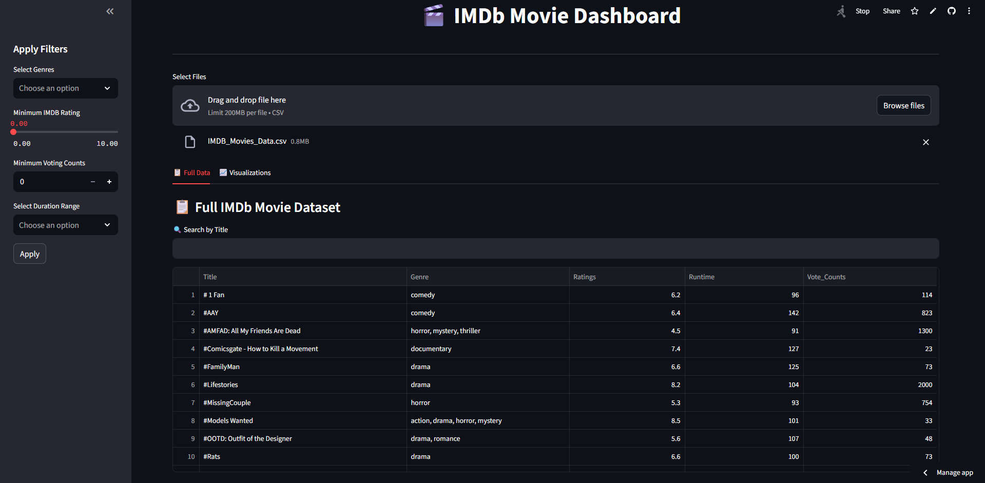
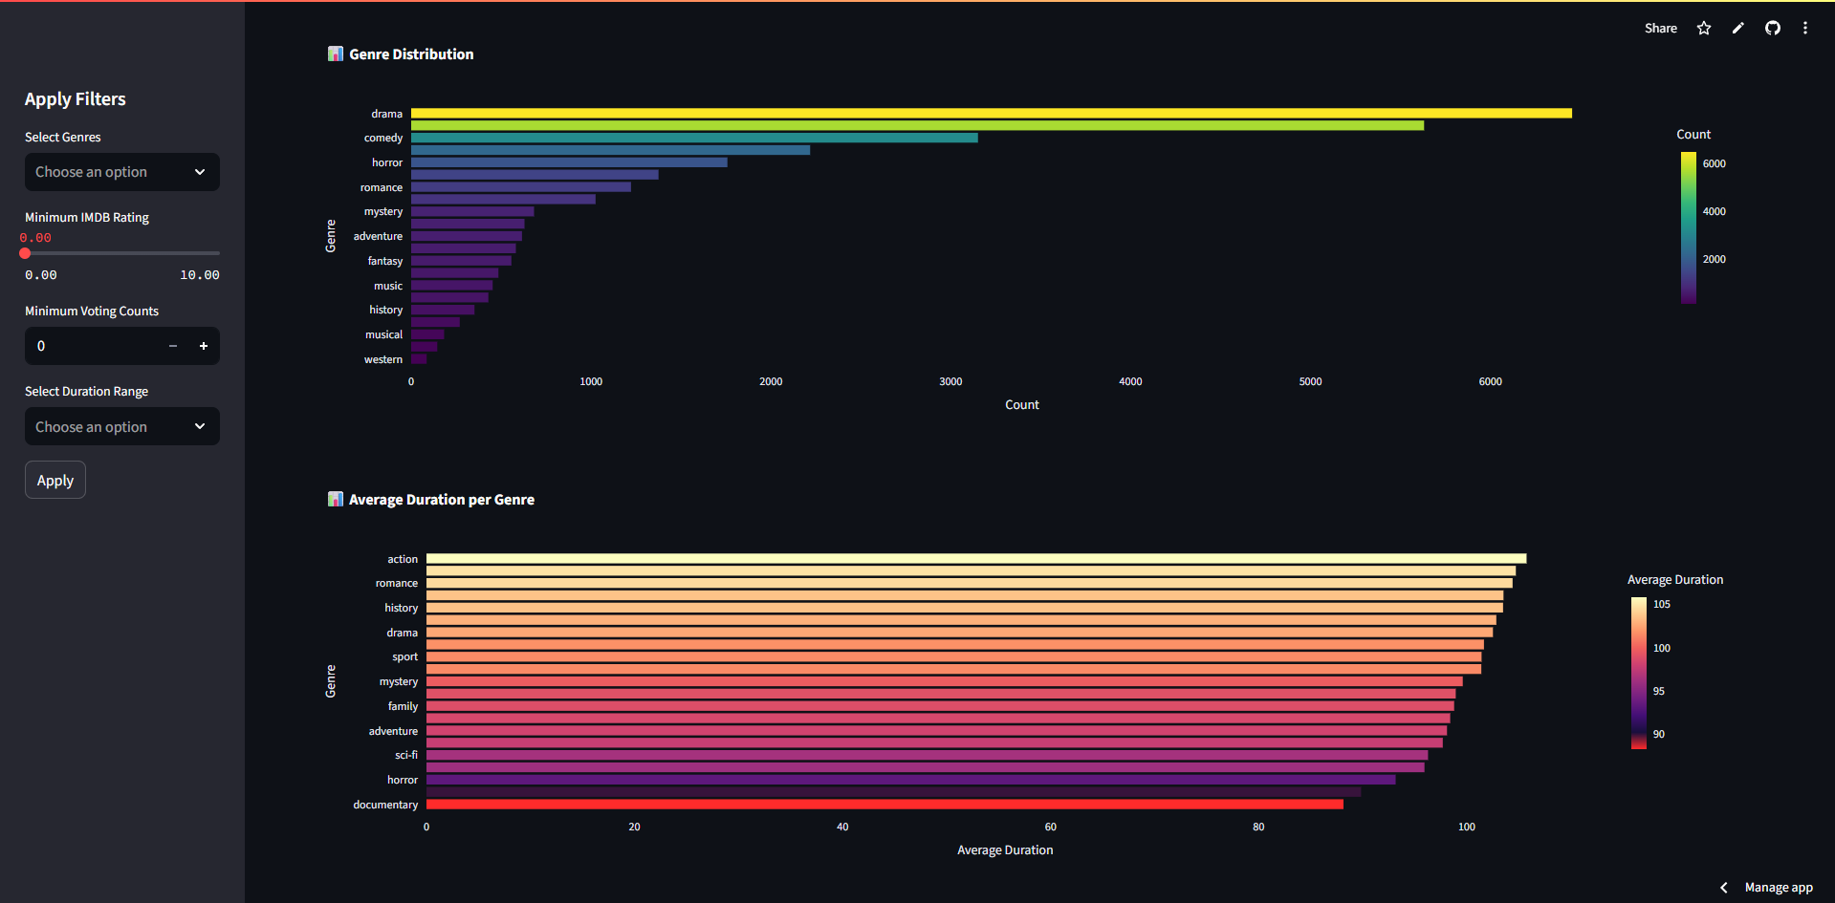
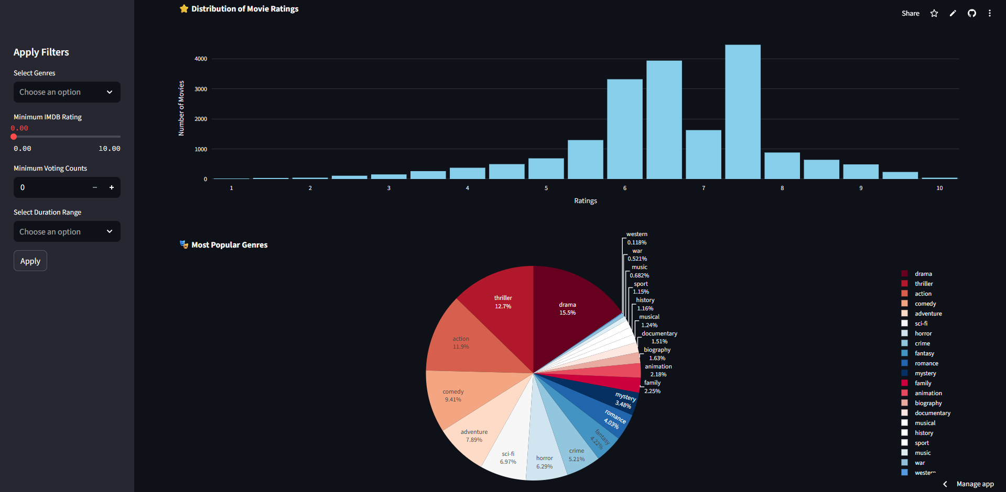
Screenshots

Slide 10
Output
Built a fully functional IMDb Dashboard with insightful visualizations.
Enabled non-technical users to interactively explore movie data.
Demonstrated strong capability in data scraping and visualization.

